Slide 1
SIT374: Project Management
Lecture 3: Scope Management

Slide 2
Project process management groups
Approved Project Management Plan
Completion Report
Monitoring
Initiation
Planning
Executing
Closing
Control
Approved Project Charter
Customer signoff

Slide 3
PROJECT MANAGEMENT PLAN (PMP)
A Project Management Plan is a formal, approved document that defines how the project is executed, monitored and controlled, and closed. It defines:
What we are going to do
How we are going to do it
How to make sure that we do
It is based on the coordination and consolidation of plan components.

Slide 4
Project Management Plan
Project Management Plan includes
The project name, description, sponsor’s name, description of the project, project organization
Major work packages (scope baseline): WBS, key products
Schedule information section (schedule baseline): Gantt Chart, Network Diagram (activities and dependencies)
Budget information section (cost baseline): Summary budget, Detailed budget
Subsidiary management plans: scope, schedule, cost management plans, etc.
Other sections: project life cycle description, development approach

Slide 5
You should be familiar with:
Project/program/portfolio
Project Management
Milestone
Deliverable
Stakeholder
Project charter
Stakeholder Register
Software Development Lifecycle
Project Lifecycle
Project Initiation
Project Planning
Project Execution
Project Monitor & Control
Project Management Plan
Project Management Knowledge Areas

Slide 6
Project Scope management
Project scope is all the work involved in creating the products and the processes used to create them.
A deliverable is a product produced as part of a project, such as hardware or software, or planning documents.
Project scope management includes the processes involved in defining and controlling what work is or not included in a project.

Slide 7
Project process management groups - Activity Map
Project Plan
☺
Acquire & manage
team
Monitor &
Control Proj.
Project
Closing
Project Charter
Scope
Time
Cost
Quality
HR
Risk
Procurement
Stakeholders
Comm.
Stakeholders
Register
Scope control &
verification
Select Sellers &
POs
Contract
Closing
Schedule control
Progress Reporting
Perform QA
Manage Stakeholders
Comm.
Contract Admin
Initiation
Planning
Executing
Mon. & Con.
Closing

Slide 8
Scope Management Processes
Plan Scope Management
Collect Requirements
Define Scope
Create WBS
Verify Scope
Control Scope
Monitoring and controlling
Planning

Slide 9
1. Plan Scope Management
Pointers to WBS/Scope Statement templates, if any.
How the scope will be defined.
How to change scope…scope creep.
How to approve deliverables.
Scope management plan
^ If the project is small, we may not need to develop a scope management plan

Slide 10
PLAN SCOPE MANAGEMENT
The scope management plan is a document that includes descriptions of how the team will prepare the project scope statement, create the WBS, verify completion of the project deliverables, and control requests for changes to the project scope.
Key inputs include the project charter, preliminary scope statement, and project management plan.
Sample Scope Management Plan

Slide 11
2. Collect Requirements
A requirement is a capability or condition that need to implemented to satisfy your customer.
Who knows project requirements better?
How can you identify project requirements?
Requirements document & requirements traceability matrix

Slide 12
Collect Requirements
Collect requirements is the process of determining, documenting, and managing stakeholder needs and requirements to meet project objectives.
It provides the basis for defining and managing project scope.
Requirements can be collected using:
interviews
focus groups, facilitated workshops
group creativity techniques e.g. brainstorming, mind mapping
surveys
Context diagrams
prototypes (commonly used technique for software projects)
Benchmarking
Requirements are documented as: Requirement specification, requirement traceability matrix (RTM).

Slide 13
Requirement specification
Requirements can be grouped into classifications allowing for further refinement:
Business requirements
Stakeholder requirements
Functional/non-functional requirements
Quality requirements

Slide 14
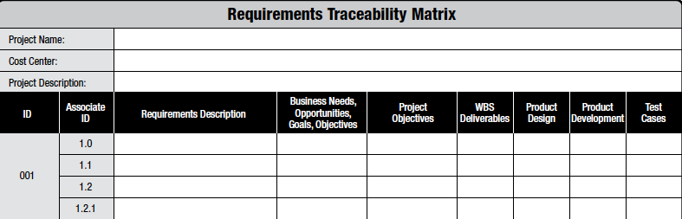
Requirement traceability matrix (RTM)
The RTM is a grid that links project requirements from origin to the deliverables:
Track requirements throughout the life cycle.
Provides a structure to track changes to scope.

Slide 15
3. Define Scope
What work need to be done.
How to make sure that only this work will be done.
In scope / Out of scope
Scope statement

Slide 16
Define Scope
Define scope is the process of developing a detailed description of the project and product.
Scope statement contains – scope description, product user acceptance criteria and detailed information on all project deliverables.
Other information: project boundaries, constraints, assumptions
Inputs for scope statement: project charter, requirement document
The main output is: a scope statement
Sample Scope Statement

Slide 17
Define Scope
Where possible, the scope statement should include how the results will be measured.
Not measurable | Measurable
A new registration system | With the new system, students will be able to register for classes using a browser or a smartphone.
The system will be fast | Response time will be under 1 second
The system will support the required volumes | 75 students must be able to add an average of 3 classes each 15-minute period.
Happy users | User satisfaction will be measured by a standardized set of questions and will measure 5 or higher on a 7-point scale.

Slide 18
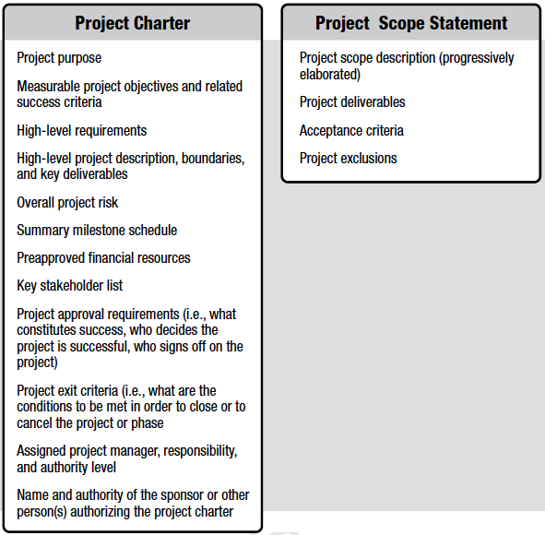
Project charter and scope statement
The project charter contains
high level information, while the
project scope statement contains a
detailed description of the scope
components.

Slide 19
4. Create Work Breakdown Structure (WBS)
Decomposition of the major deliverables into smaller and manageable pieces.
Scope baseline (WBS + WBS Dictionary)

Slide 20
Create WBS
A work breakdown structure (WBS) is a deliverable oriented grouping of the work involved in a project that defines the total scope of the project.
A WBS is a foundation document in project management because it provides the basis for planning and managing project schedules, costs and changes.
Main tool: decomposition – subdividing the project deliverables into smaller pieces.
The main outputs include:
project scope statement updates
work breakdown structure
WBS dictionary
scope baseline

Slide 21
Create WBS
WBS can be created around – project products, project phases or using project management process groups.
WBS can be defined using various levels
Level 1- The name of the entire project is the top box
Level 2- Main grouping of the work listed in the second tier of the box
Each of the task can be further broken down to subsequent boxes to show the hierarchy of boxes.
WBS can be created in a chart form or tabular form.
Numbering format (MS Project) – PMI Practice Standard for Work Breakdown Structure

Slide 22
Create WBS
Work package: is a task at the lowest level of WBS
Work package represents the piece to be cost estimated, scheduled, monitored and controlled by the project manager.
100% rule : WBS captures – in terms of work to be completed.

Slide 23
WBS…How to?
Top-Down - Start with end goal and keep decomposing
Project → components → subcomponents → work packages
Project → phases → deliverables → activities → work packages
Project → SDLC activity → … → work packages
Project → stakeholder → user roles → … → work packages
When to stop?

Slide 24
Other approaches
The Analogy Approach: use similar projects as starting points
Bottom Up: identify the specific tasks and aggregate them to organize them to form higher levels of WBS
Mind Map: uses branches radiating out from a core idea to structure thoughts and idea. Non linear approach to organize ideas. Mind map can be translated to tabular or chart form of WBS

Slide 25
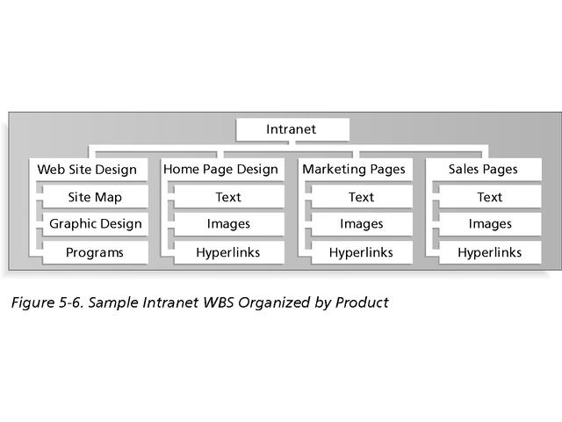
Sample Intranet WBS Organized by Product

Slide 26
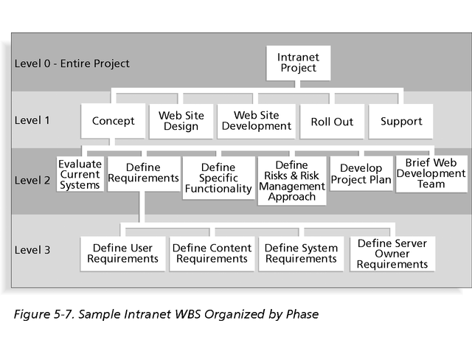
Sample Intranet WBS Organized by Phase

Slide 27
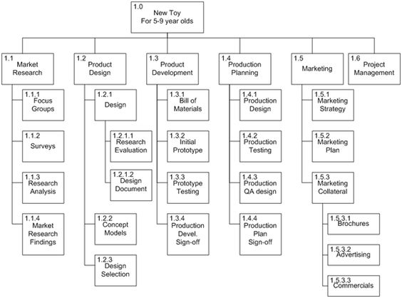
WBS example (By Phase)
Note : project management is a task at Level 2. WBS represents all the task which needs to be done to complete the project.

Slide 28
Intranet WBS in Tabular Form
1.0 Concept
1.1 Evaluate current systems
1.2 Define requirements
1.2.1 Define user requirements
1.2.2 Define content requirements
1.2.3 Define system requirements
1.2.4 Define server owner requirements
1.3 Define specific functionality
1.4 Define risks and risk management approach
1.5 Develop project plan
1.6 Brief Web development team
2.0 Web Site Design
3.0 Web Site Development
4.0 Roll Out
5.0 Support

Slide 29
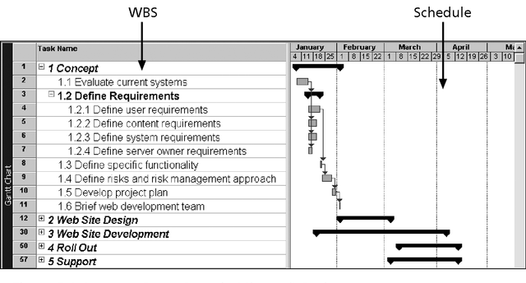
Intranet WBS and Gantt Chart in MS Project

Slide 30
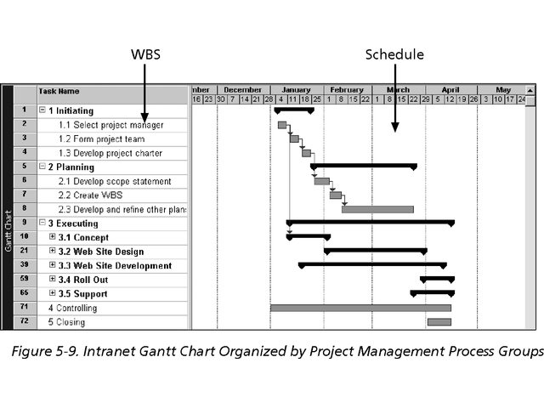
WBS – By Process Groups
Microsoft Numbering Format has been used here.

Slide 31
Create WBS
Basic principles for creating WBS:
a unit of work only appear once
the work content of a WBS item is the sum of the WBS items below it
a WBS item is the responsibility of only one person/team
the WBS must be consistent with the way in which work will be carried out
each WBS item must be documented to ensure accurate understanding the scope of work

Slide 32
The WBS Dictionary and Scope Baseline
Many WBS items are vague and must be explained in more detail so people know what to do and can estimate how long the work will take and what it will cost.
A WBS dictionary is a document that describes detailed information about each WBS item. (Pg. 72- PMI Practice Standard for WBS)
The approved project scope statement and its WBS and WBS dictionary form the scope baseline, which is used to measure performance in meeting project scope goals.

Slide 33
Activity 2
Consider a project aimed at upgrading an organization's internal communication system. In the bottom-up approach, we start by identifying specific tasks or low-level activities and then group them into higher-level categories. Here's how it might unfold:
Starting with Specific Tasks:
Configure new email server settings.
Migrate user data to the new platform.
Train staff on new communication tools.
Develop custom integrations for legacy systems.
Test the new system for data integrity and security.
Prepare user manuals and troubleshooting guides.
Group tasks into higher-level categories and form WBS

Slide 34
Activity 3
Look into Hope Health case study
Try to create WBS based on project management process groups and project phases.

Slide 35
Verify Scope
Scope verification is the process of formalising acceptance of the completed project deliverables.
Key benefit of this process is that it brings objectivity to the acceptance process and increases the chance of final product, service, or result acceptance by validating each deliverable (Project Management Institute, 2013)
The main outputs include:
accepted deliverables
requested change

Slide 36
Control scope
Changes may be requested by any stakeholder involved with the project and may occur at any time throughout the project life cycle.
Needs to be approved, deferred, or rejected.
Impact on time and cost could be evaluated to facilitate decision-making.
Controlling scope is the process of managing and controlling changes to project scope.
The main outputs include:
Project document/plan updates
Change requests
Work performance measurements

Slide 37
Activity 4
You are a project analyst at TechSolutions Inc., a company that recently undertook an ambitious IT project to develop a comprehensive inventory management system for a large retail chain. The project was expected to streamline inventory tracking, enhance data accuracy, and improve order fulfillment processes.
However, six months into the project, it became clear that the project was significantly behind schedule and over budget. Upon closer inspection, it was discovered that the project's scope had expanded considerably without proper approvals or adjustments to the budget and timeline.
The initial project scope included the development of a core inventory tracking system, integration with existing point-of-sale systems, and user training.
However, as the project progressed, additional features and functionalities were incorporated, such as advanced analytics, real-time inventory updates across multiple channels, and customized reporting for different departments. These enhancements were not part of the original scope and were added without a formal change request process or additional resource allocation.

Slide 38
Activity 4 (cont’d)
Analyze the situation and identify the underlying reasons why the IT project is failing. Focus on how the issues related to scope management, specifically scope control, contributed to the project's challenges. Discuss the impact of these scope management issues on the project's timeline, budget, and overall success. Additionally, suggest measures that could have been taken to prevent these problems from occurring in the first place. Your analysis should cover the following aspects:
Scope Creep Identification: Explain how the lack of control over the project's scope led to the addition of new features and functionalities that were not initially planned.
Impact Analysis: Assess the impact of this scope creep on the project's resources, timeline, and budget. Consider how these unplanned changes affected team workload, project milestones, and stakeholder expectations.
Preventive Measures: Suggest strategies or processes that TechSolutions Inc. could have implemented to avoid the issues related to scope control. Discuss how proper scope management practices could have helped in maintaining the project's focus and alignment with the original objectives.

Slide 39
Scope management with predictive and adaptive life cycles
Adaptive life cycle
The detailed scope is defined and approved for each iteration when it begins.
Processes of collecting requirements, defining scope and creating WPS are repeated for each iteration. At the beginning of each iteration, the highest-priority items on the backlog list will be selected to be delivered in the next iteration.
Predictive life cycle
The scope is defined at the beginning of the project and any changes are progressively managed.
In predictive life cycle, the processes are performed toward the beginning of the project and updated as necessary, using change control process.

Slide 40
Summary
Scope management
Plan
Collect requirements
Define scope
Create WBS
Verify/control scope
Scope management in predictive and adaptive life cycles

Slide 41
What’s next
Next area of project management – time/schedule management

